Slide 1
Machine Learning
Gradient Descent Algorithm
Linear Regression
Non-Linear Regression
Logistic Regression
Decision Trees
Regression Trees
Classification Trees
Clustering Algorithms
K-Means
Hierarchical clustering
DB-Scan
Mean Shift
GMM
Support Vector Machine
Deep Learning
MLP
CNN
Datasets
Breast Cancer Wisconsin
MIMIC-III
Framingham Heart Study
Alzheimer’s Disease Neuroimaging Initiative
Drug discovery
Microbiome

Slide 2
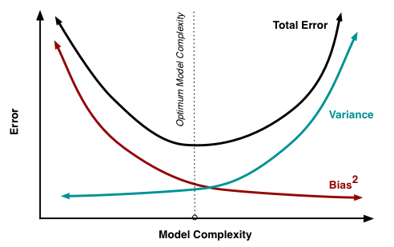
C5 – Bias Variance Tradeoff
my humble ML course

Slide 3
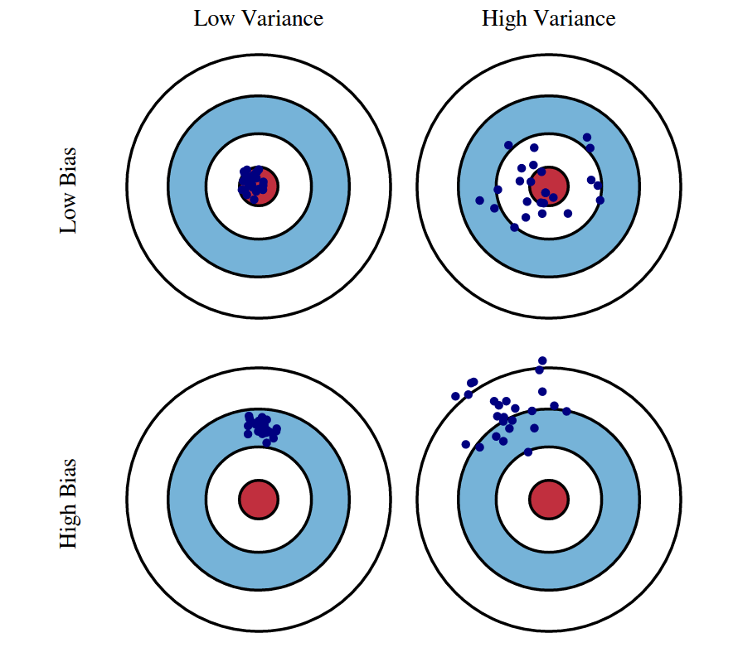
my humble ML course
Bias variance tradeoff
TODO

Slide 4
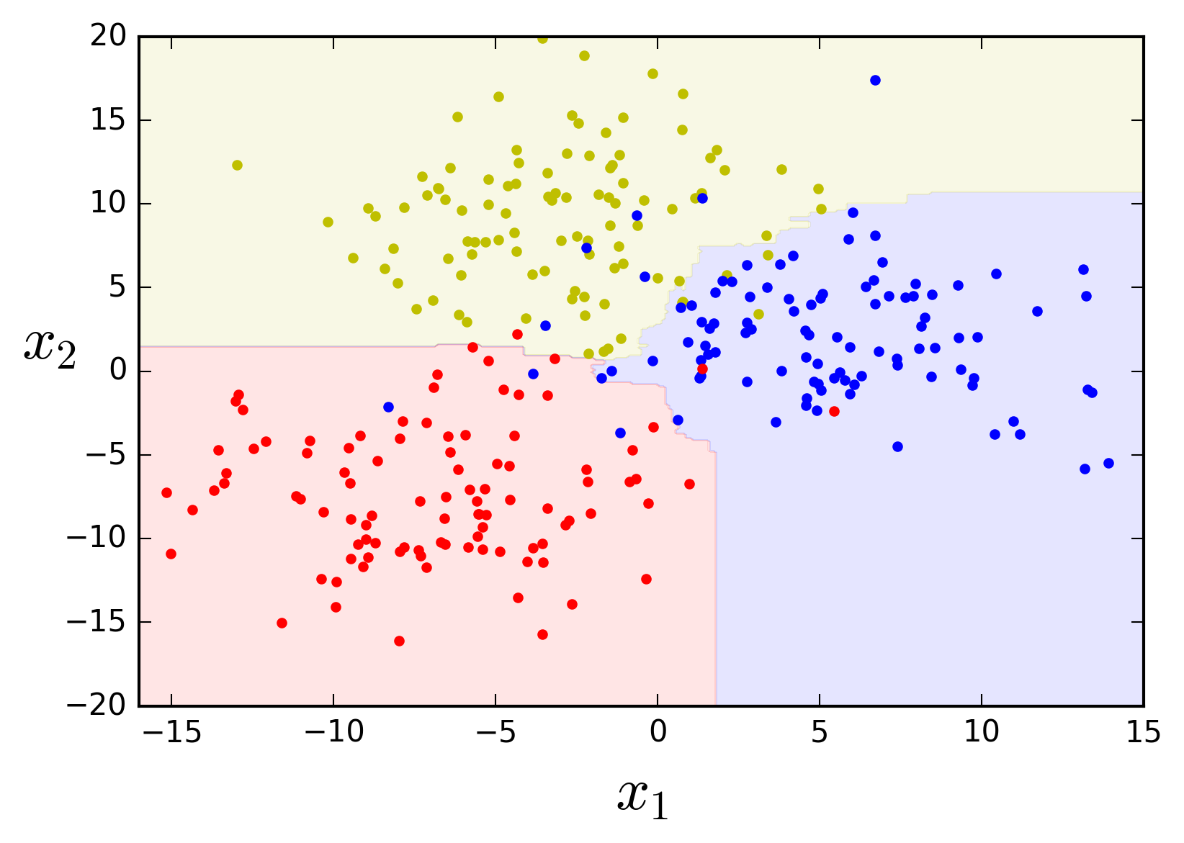
C5 – Random Forest
my humble ML course

Slide 5
my humble ML course
Random Forest
TODO

Slide 6
my humble ML course
Feature importance
TODO

Slide 7

my humble ML course
Code

Slide 8
my humble ML course
Bibliography
https://github.com/kamperh/data414
https://polakowo.io/datadocs/docs/machine-learning/tree-based-models
https://towardsdatascience.com/why-random-forests-outperform-decision-trees-1b0f175a0b5
https://www.statistics.cool/post/why-do-random-forests-work/
https://luisvalesilva.com/datasimple/random_forests.html
Notes:
https://towardsdatascience.com/gradient-descent-algorithm-a-deep-dive-cf04e8115f21
https://towardsdatascience.com/all-machine-learning-models-explained-in-6-minutes-9fe30ff6776a
https://medium.com/grabngoinfo/gradient-descent-vs-616ba269de8d

